Slide 1
Hello, Bots!
Ryan Volum
Christopher Harrison

Slide 2
Getting started
1
Creating the project
6
Creating your first bot
2
Installing and running the emulator
7
Sample bots
3
Title for Section 3. Size 20 pt
8
Title for Section 8. Size 20 pt
4
Title for Section 4. Size 20 pt
9
Title for Section 9. Size 20 pt
5
Title for Section 5. Size 20 pt
10
Title for Section 10. Size 20 pt

Slide 3
Creating a project

Slide 4
Getting your bot project started
Step 1: Create your package.json file
Step 2: Install botbuilder npm package
Step 3: Profit

Slide 5
What's in the botbuilder?
bot
Stores the logic
connector
How to talk to the bot
Chat (preferred)
Console
Other utilities

Slide 6
Creating your bot project

Slide 7
Creating your bot
Create the connector
We'll start with the console connector
Create the bot
Pass in the connector
Add logic
Done through dialog
Communicate with the user
Done through the session

Slide 8
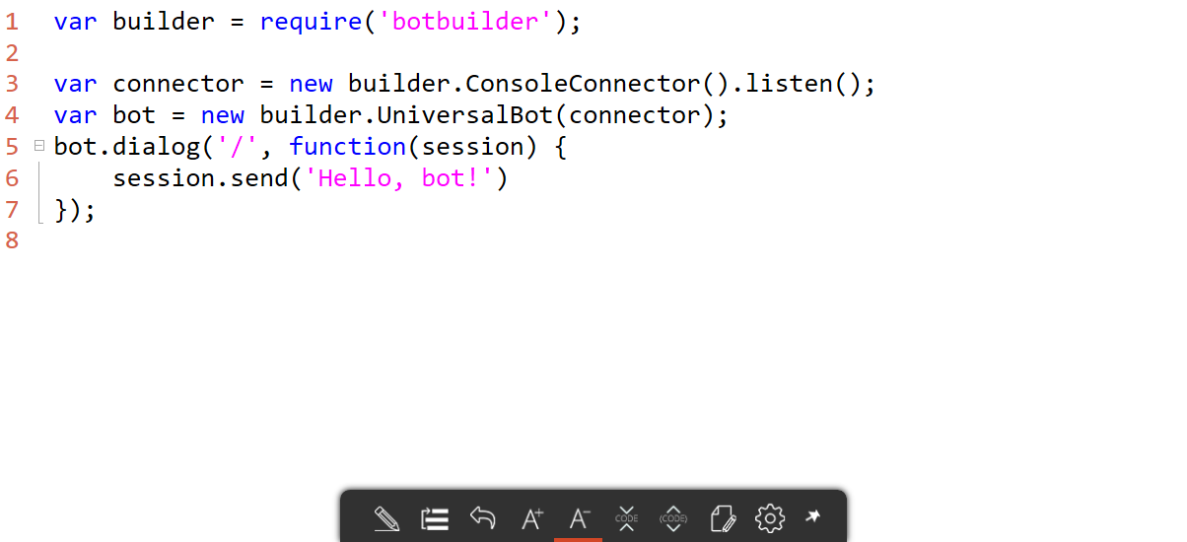
Your first bot

Slide 9
Your first bot

Slide 10
Receiving information from the user
The initial message is in session.message
Often sent to LUIS for processing
More on that later

Slide 11
Asking the user for information
Done through prompts
Text
Number
Choice
Received in response

Slide 12
Basic waterfalls
Standard logic falls from one method to the next
Pass in the series of methods when you create the dialog

Slide 13
Interacting with the user

Slide 14
You typically talk to bots through other IM channels
Facebook
Slack
Skype
Text
Etc.

Slide 15
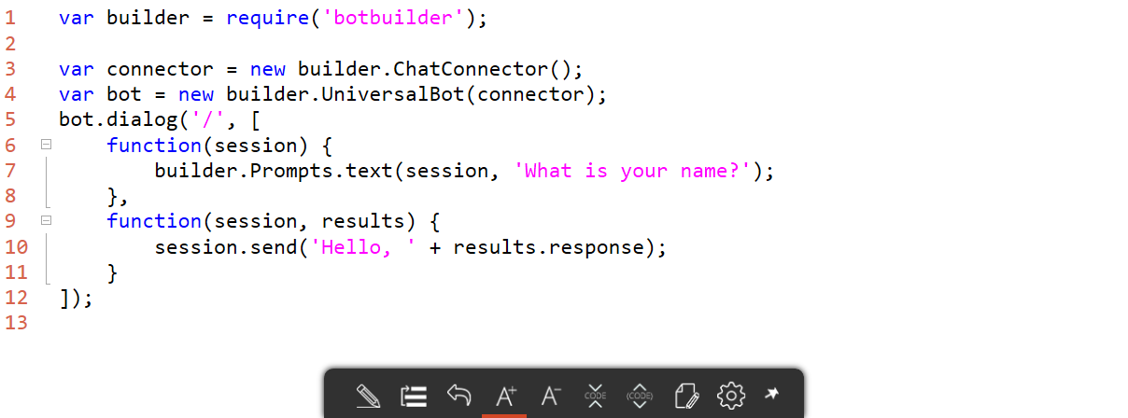
One connector to rule them all
Create your bot using the ChatConnector
Register your bot
Choose the various services for your bot

Slide 16
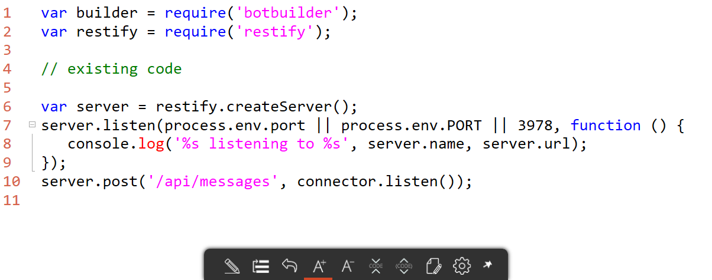
Need to host your bot
Any web server will do
For local testing, you'll typically use restify or express

Slide 17
Testing your bot
At the end of the day, it's just a REST service
You could just make normal REST calls
To make things easier, you can use the Bot Framework Channel Emulator
https://docs.botframework.com/en-us/tools/bot-framework-emulator/

Slide 18
Using the chat connector

Slide 19
When all else fails, look at what someone else has done for a pattern.

Slide 20
Bot framework samples and examples
Examples
https://github.com/Microsoft/BotBuilder/tree/master/Node/examples
Bot directory
https://bots.botframework.com/

